Slide 1

Exploring and Predicting Bitcoin with Machine Learning
Bitcoin is a decentralized digital currency that has gained significant attention in recent years. Machine learning algorithms can be used to analyze Bitcoin market data and uncover patterns that may assist in predicting its price movements.

Slide 2
Data Sources and Preprocessing
Data Sources
Preprocessing
Feature Engineering
Historical Bitcoin price data, trading volume, and other market indicators are collected from various reliable sources, such as cryptocurrency exchanges and data aggregators.
The data is cleaned, transformed, and normalized to ensure it is in a suitable format for machine learning analysis.
Relevant features are engineered from the raw data to capture key market dynamics and facilitate more accurate predictions.

Slide 3

Methodology: Machine Learning Algorithms
1
Regression Models
2
Classification Models
3
Time Series Analysis
Algorithms like linear regression and decision trees are used to predict future Bitcoin prices based on historical data.
Classifiers such as logistic regression and support vector machines can be employed to identify patterns and make binary predictions (e.g., buy/sell signals).
Techniques like ARIMA and long short-term memory (LSTM) networks are applied to capture the temporal dynamics of the Bitcoin market.

Slide 4
Feature Engineering and Selection
Feature Engineering
Feature Selection
Feature Importance
Relevant features are engineered from the raw data, such as technical indicators, sentiment analysis, and macroeconomic factors.
Techniques like correlation analysis and recursive feature elimination are used to identify the most informative features for the machine learning models.
The relative importance of each feature is analyzed to understand the key drivers of Bitcoin price movements.

Slide 5
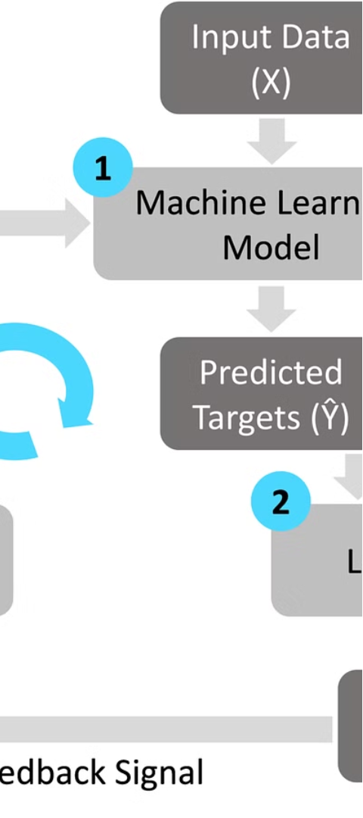
Model Training and Validation
1
Model Training
The machine learning models are trained on the prepared dataset, using techniques like cross-validation to ensure robust performance.
2
Model Evaluation
The models are evaluated using appropriate metrics, such as mean squared error, accuracy, and F1-score, to assess their predictive capabilities.
3
Model Selection
The best-performing model is selected for further analysis and deployment in the real-world Bitcoin trading environment.

Slide 6
Limitations and Challenges
Data Availability
Volatility
The limited availability and potential biases in historical Bitcoin data can pose challenges for reliable model training and prediction.
The high volatility and unpredictable nature of the Bitcoin market can make it difficult for machine learning models to consistently and accurately predict price movements.
External Factors
Computational Resources
Factors outside the scope of the data, such as regulatory changes and global economic conditions, can significantly impact the Bitcoin market and introduce additional complexity.
Effective machine learning on large, high-frequency Bitcoin datasets may require significant computational resources and specialized infrastructure.

Slide 7
Results and Findings
Predictive Performance
Influential Factors
Insights and Patterns
The analysis reveals that factors like trading volume, sentiment analysis, and technical indicators are among the most influential in determining Bitcoin prices.
The research uncovers interesting patterns and relationships within the Bitcoin market that can inform trading strategies and investment decisions.
The machine learning models demonstrate promising results in predicting short-term and medium-term Bitcoin price movements, with varying degrees of accuracy.

Slide 8




Conclusion and Future Directions
Potential and Challenges
The research demonstrates the potential of machine learning in analyzing and predicting the volatile Bitcoin market, but also highlights the ongoing challenges that require further investigation.
Continuous Improvement
Future research should focus on enhancing the predictive accuracy of the models, incorporating new data sources, and exploring more advanced machine learning techniques.
Real-World Applications
The findings from this study can be applied to develop robust trading strategies and investment decision support systems for the Bitcoin market.

